Slide 1
Geo-Mechanical Capabilities of Enquest
Post drill Geomechanics:
Drilling operational reports study and Mechanical issues determination and mapping
Post drill 1D mechanical earth modeling and wellbore stability analysis using field’s drilled wells or nearby fields wells
3D geomechanical simulation using post drilled wells 1DMEMs, seismic data and static reservoir model
4D geomechanical simulation by coupling the 3D MEM to Dynamic simulation model for:
Fault and fracture reactivation analysis
Subsidence due to production or Uplifting due to injection analysis
Hydraulic fracturing sweet spots determination
CCS, CCUS containment analysis
Pre-Drill Geomechanics:
Wellbore stability analysis using post drill 1DMEMs or 3D/4D models
Safe and stable mud window determination
Drilling
Casing seat determination
Hydraulic fracturing
Sand production control and perforation optimization
Realtime geomechanics (On site or Remotely):
Drilling issues monitoring and propose real time treatments Wellbore stability profile updating while drilling using LWD/MWD and real time Mud logs and drilling parameters
Real time Casing design updating
Propose FIT,PIT,LOT and XLOT test intervals
Using the lesson learns for the future wells planning and design

Slide 2
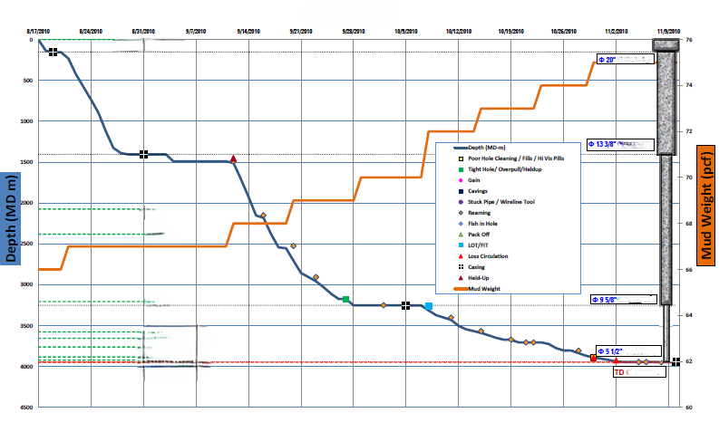
Drilling operational reports study and Mechanical issues determination and mapping

Slide 3
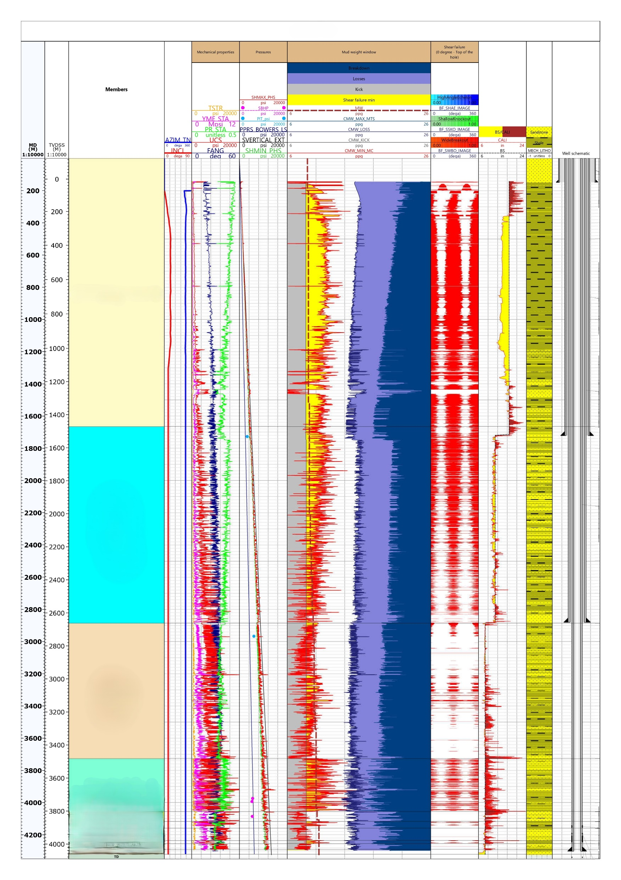
Post drill 1D mechanical earth modeling and wellbore stability analysis using field’s drilled wells or nearby fields wells

Slide 4
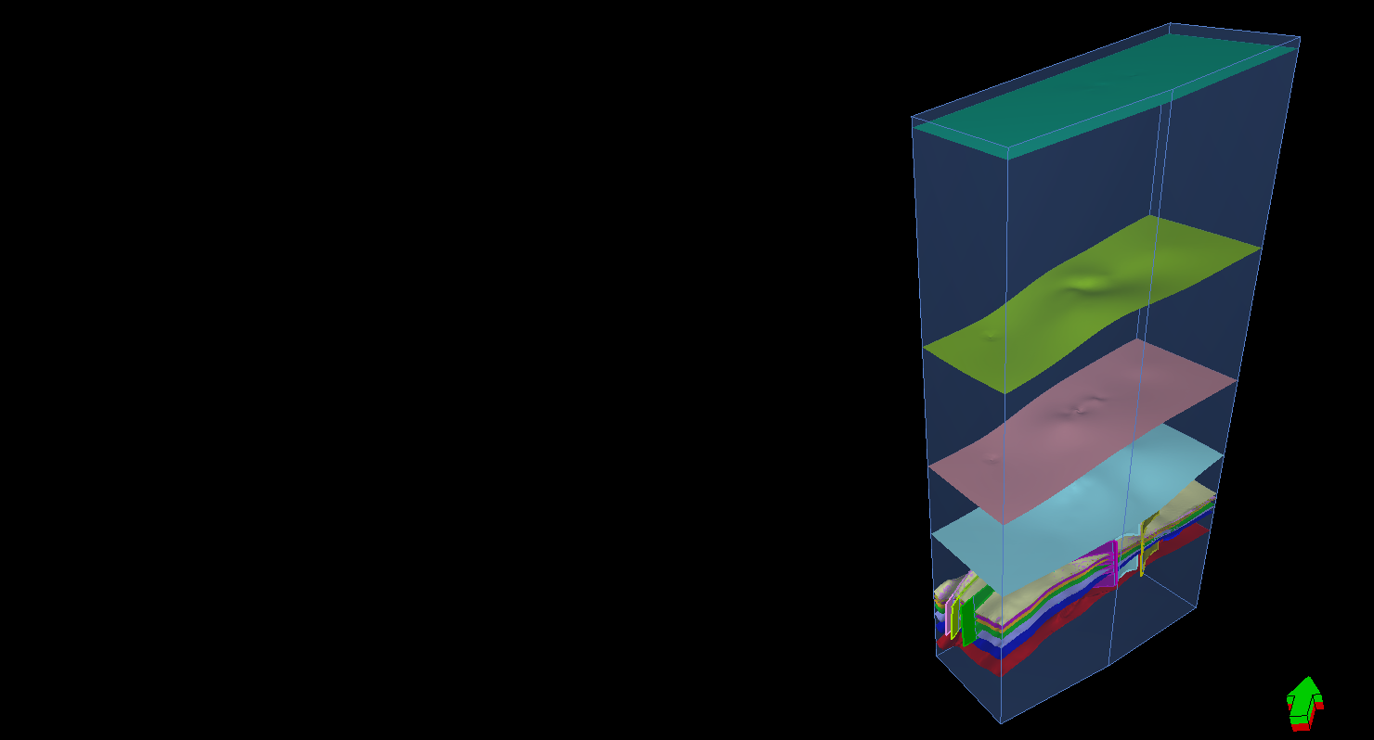
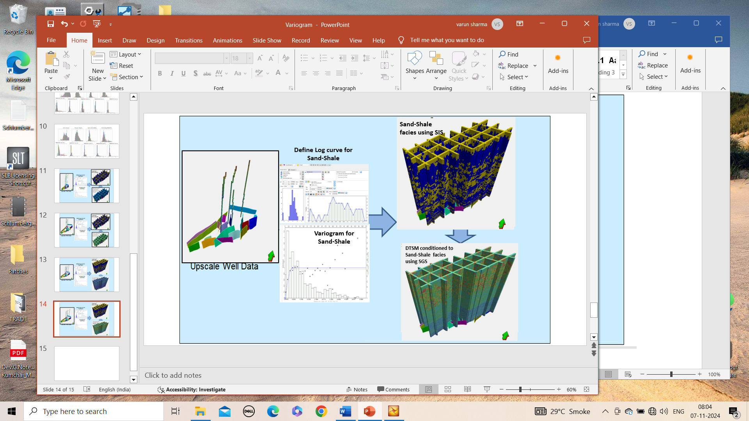
3D geomechanical simulation using post drilled wells 1DMEMs, seismic data and static reservoir model

Slide 5
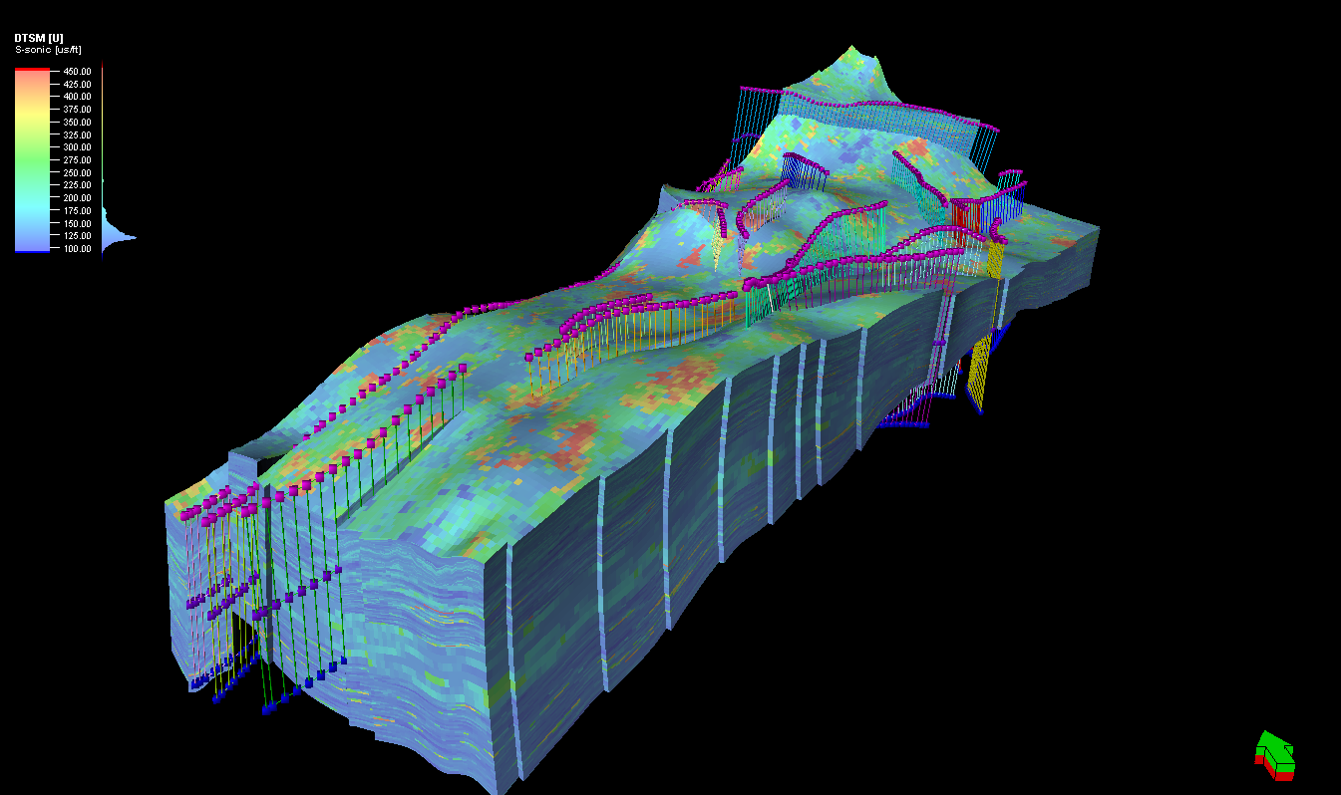

Slide 6
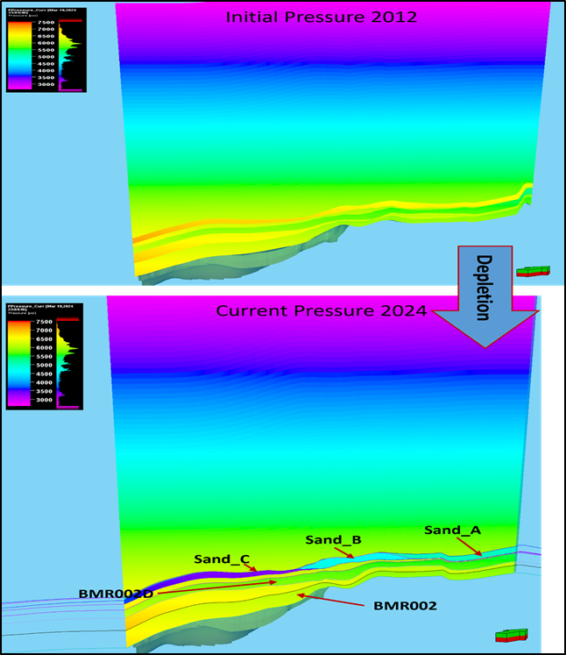
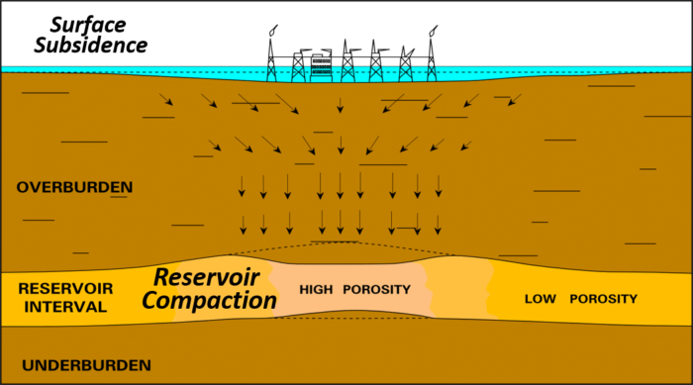
4D geomechanical simulation by coupling the 3D MEM to Dynamic simulation model for:
Subsidence due to production or Uplifting due to injection analysis

Slide 7
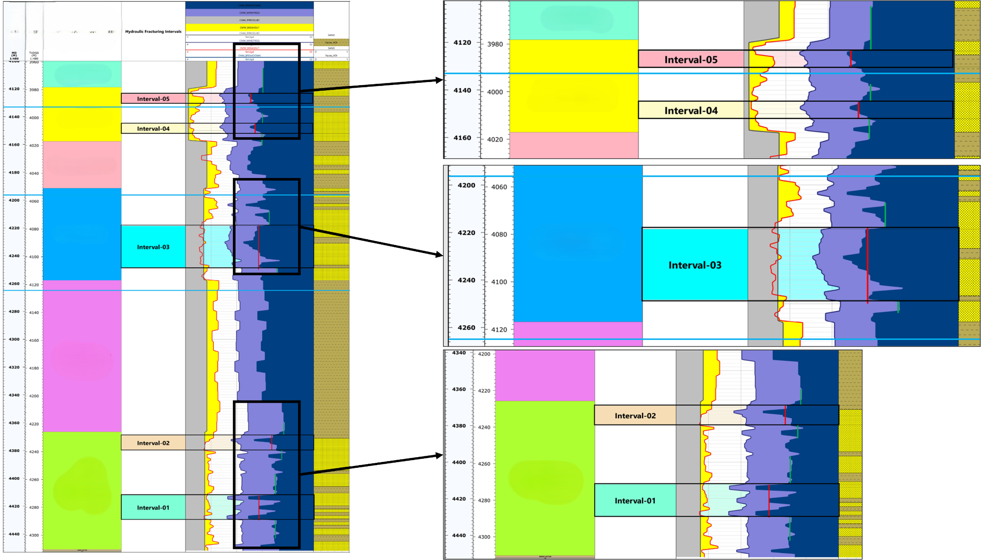
4D geomechanical simulation by coupling the 3D MEM to Dynamic simulation model for:
Hydraulic fracturing sweet spots determination

Slide 8
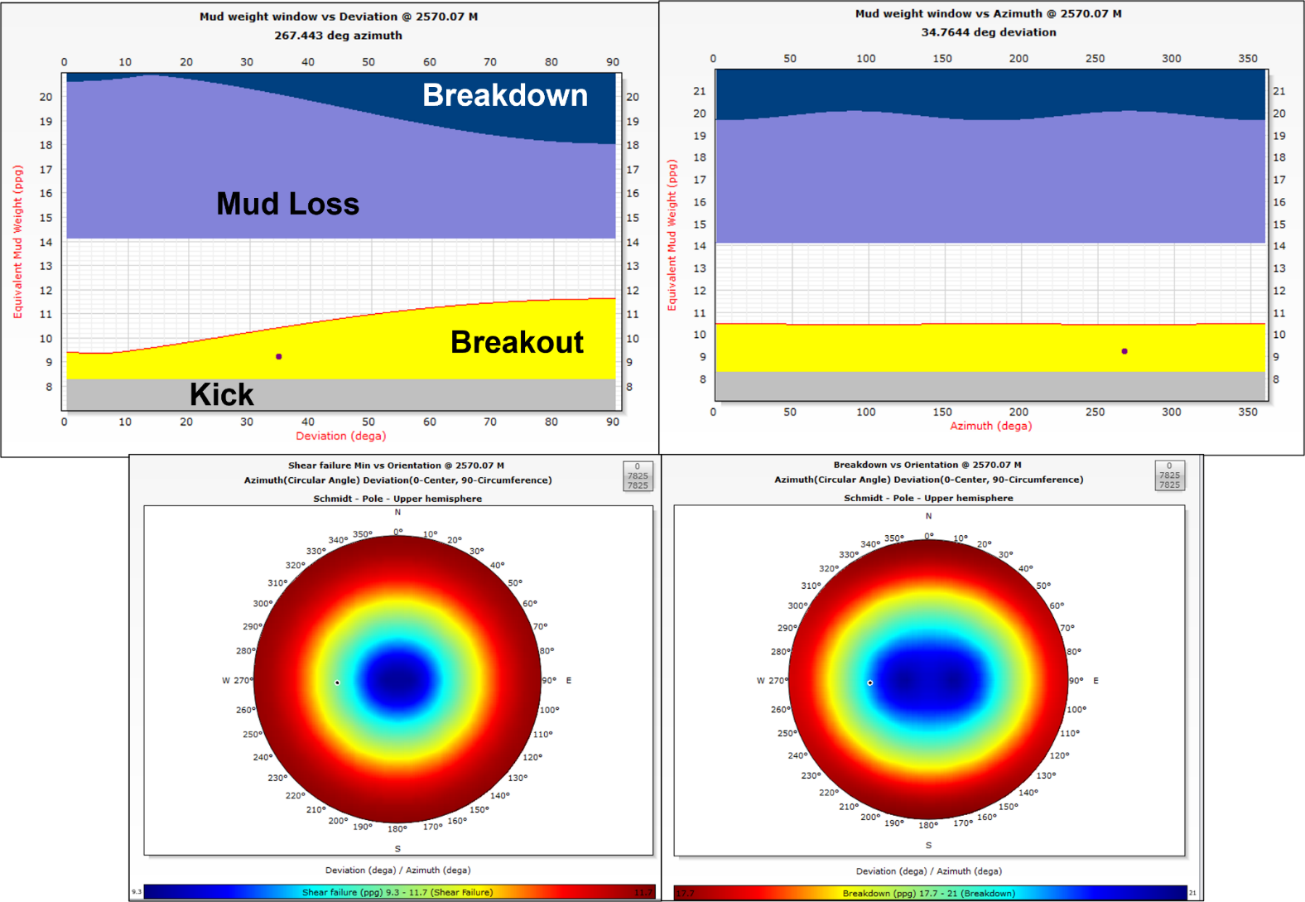
Pre-Drill Geomechanics:
Wellbore stability analysis using post drill 1DMEMs or 3D/4D models

Slide 9
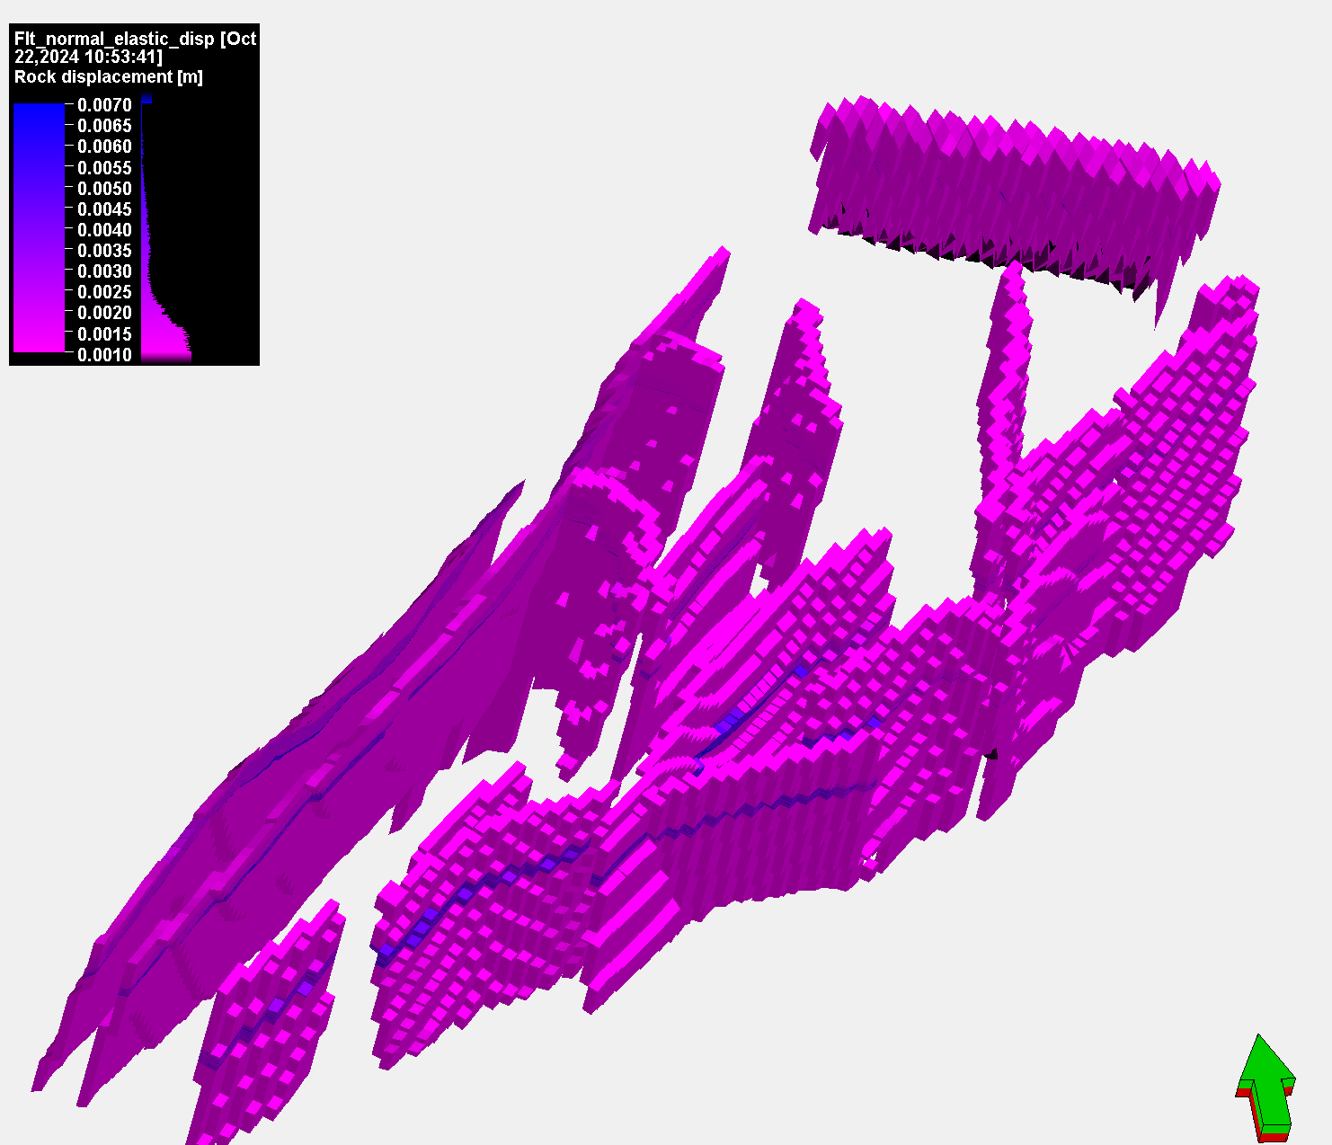
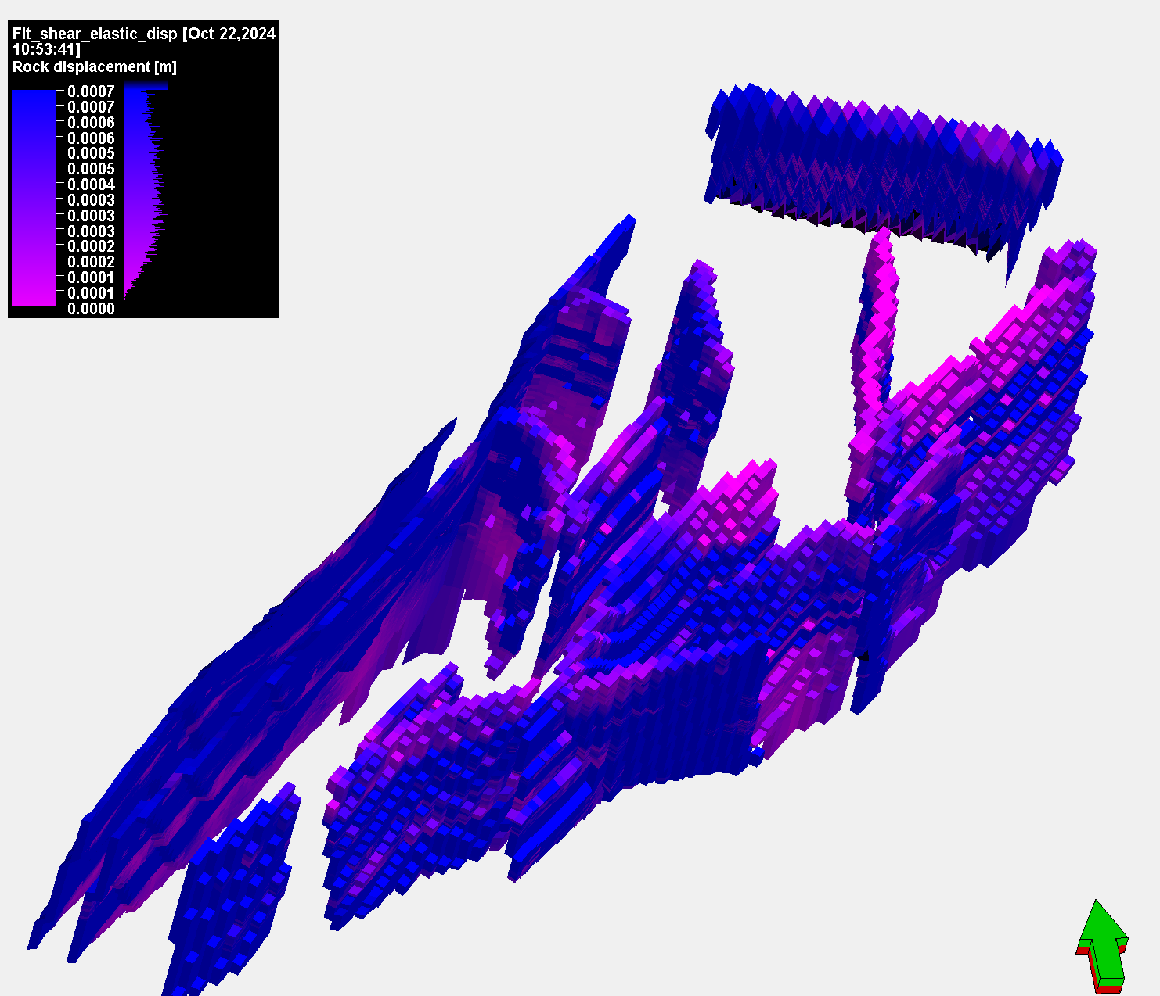
4D geomechanical simulation by coupling the 3D MEM to Dynamic simulation model for:
Fault and fracture reactivation analysis

Slide 10
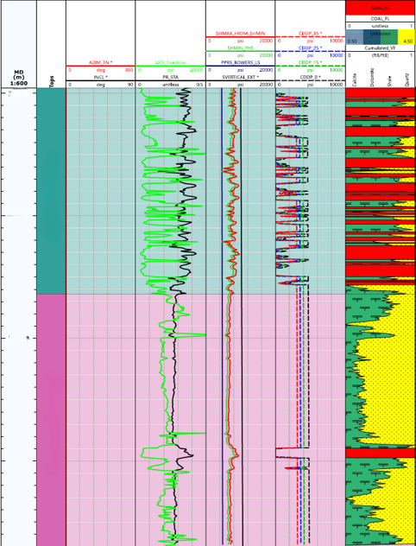
Sanding Analysis

Slide 11
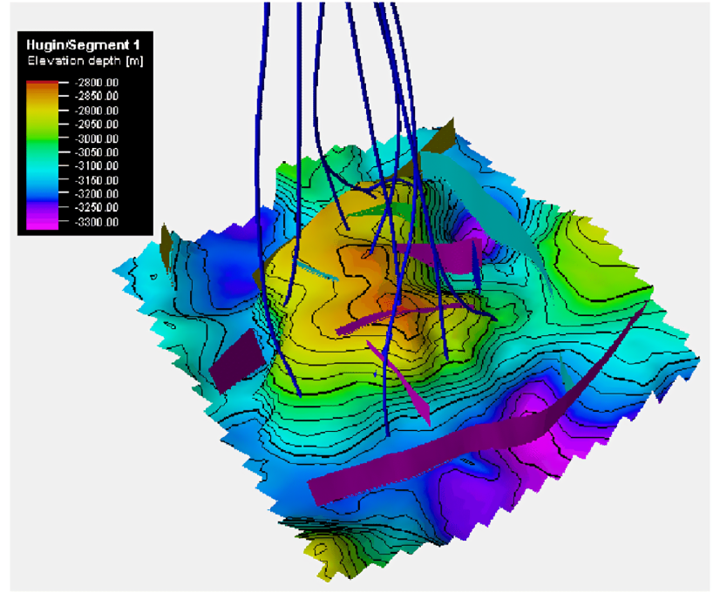

Slide 12
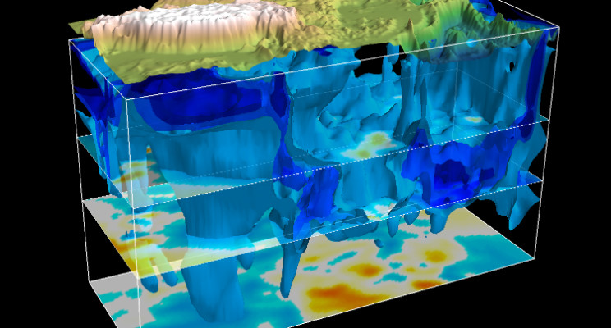

Slide 13
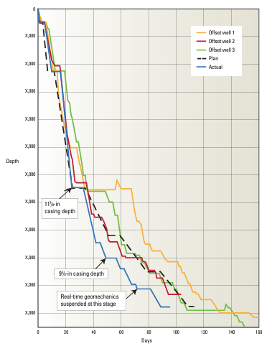
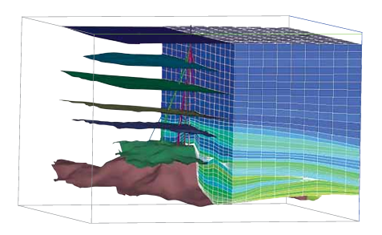
Realtime geomechanics (On site or Remotely):

Slide 14
